Slide 1
Week 5
CSS Again; Again?

Slide 2
Agenda
Responsive design problems
Chrome inspection and device emulation
Media Queries
Measurement on devices

Slide 3
Resources
CSS Relative Units
Media Queries
Google chrome dev tools not responding?

Slide 4
Agenda
Review of git workflow (again…)
Barebones principles of responsive design.
‘Playing around with boxes:’ exploring relative units of measurement to create a coherent and desirable experience.
Using media queries to max a responsive nav bar.

Slide 5
Git, becuase you should.
You’re welcome.

Slide 6
Responsive Nav Bar

Slide 7
Nav
Content
Nav
Content

Slide 8
Relative Sizing in CSS
ditch the px

Slide 9
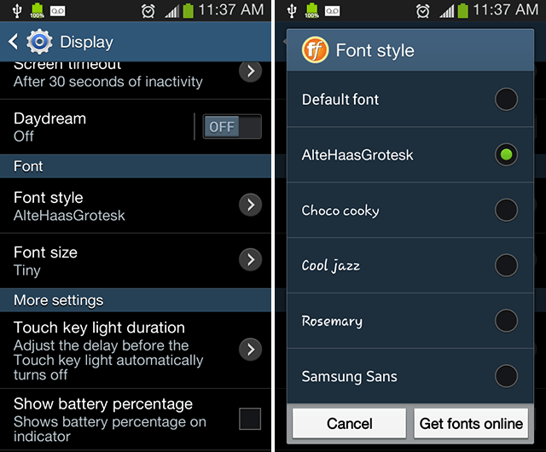
Base Font
http://www.makeuseof.com/tag/4-ways-change-android-fonts/

Slide 10
Units of measurement on web pages
Percent
REM and EM
VW
VH
VMIN
VMAX

Slide 11
ex ch ic em lh rlh vh vw vi vb vmin vmax px rem mm q cm in pt pc %

Slide 12

em
Traditionally the width of a capital M in metal typesetting
In modern typography, equal to specified point size
Proportional to parent
By Willi Heidelbach, CC BY 2.5, https://commons.wikimedia.org/w/index.php?curid=154912

Slide 13
em
Base font: 14px
1 em = 14px
2 em = 28px
0.25 em = 7px
Notes:
Hello I am DAVIDson of AWAD and I am cool

Slide 14
ex ch ic em lh rlh vh vw vi vb vmin vmax px rem mm q cm in pt pc %

Slide 15
rem (root element)
Base font: 10px
1.5 rem = 15px
3 rem = 30px
1 rem = 10 px
Notes:
Hello I am DAVIDson of AWAD and I am cool

Slide 16
Combining rem and em
Base font: 10px BODY
1.5 rem = 15px PARAGRAPH
2 em = 30px IMPORTANT
1 em = 30 px
1 rem = 10 px
LESS IMPORTANT
0.8 rem = 8 px
LEAST IMPORTANT

Slide 17
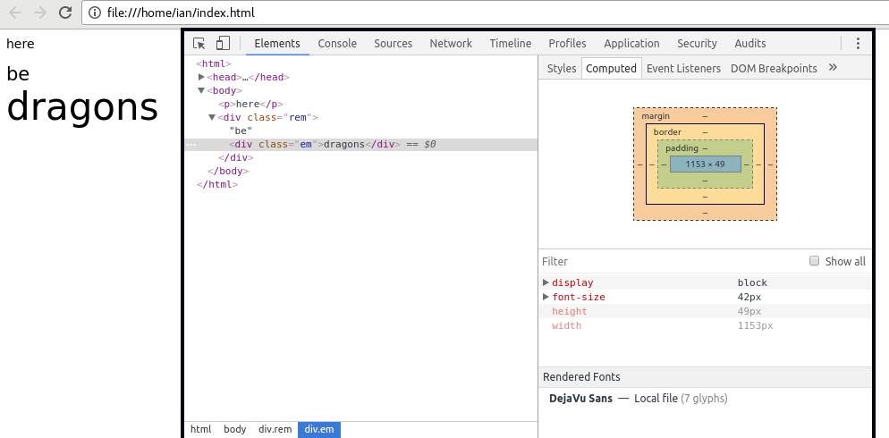
Viewing Computed Values
html {
font-size: 14px;
}
.rem {
font-size : 1.5rem;
}
.em {
font-size: 2em;
}

Slide 18
Q&A

Slide 19
ex ch ic em lh rlh vh vw vi vb vmin vmax px rem mm q cm in pt pc %

Slide 20
Percentage-Based Dimensions
width: 500px;
Percentages relative to parent element
Margins and padding only relative to parent element’s width
height: 750px;

Slide 21
width: 500px;
margin-top: 30%;
/* 0.30 × 750px */
height: 750px;
margin-left: 50%;
/* 0.50 × 500px */
height: 80%;
/* 0.80 × 750px */
width: 50%;
/* 0.50 × 500px */

Slide 22
calc
p {
margin-left: calc(30% - 20px);
}

Slide 23
Q&A

